Slide 1
Data Structures-1

Slide 2
Data Structures:
A data structure is a way of organising data in a computer or program.
The core collection built-in data type or data structures are:
List
Tuple
Set
Dictionary
We have already study one: list
List is a collection which is ordered and changeable.
It allows duplicate members.
In Python, elements can be anything.

Slide 3
Tuple:
Tuple is a collection which is ordered and unchangeable(immutable).
Allows duplicate members.
Tuples are like lists. The differences between tuples and lists are :
The tuple cannot be changed unlike lists.
Tuples use parenthesis, whereas lists use square brackets.

Slide 4
Creating tuple:
A tuple is created by placing all the items(elements) inside parenthesis (), separated by commas.
The parenthesis are optional, however, it is a good practise to use them.
A tuple can have any number of items(elements) and they may be of different types( integer, float, string, etc.).
T=(1,2,3,4)
T=(‘hari’,’mohan’,’james’)
T=(‘hari’,’mohan’,20,30,40)

Slide 5
Creating Empty tuple:
T=()
Creating tuple without using parenthesis:
T=1,2,3,’ram’
This is known as tuple packing.
Creating tuple with one element:
Placing element inside parenthesis is not sufficient. We need to provide single comma after element.
T=(5,)

Slide 6
Accessing tuple elements:
We use indexes to access the elements of a tuple
- indexing
-5 | -4 | -3 | -2 | -1
tuple
10 | 20 | 30 | 40 | 50
0 | 1 | 2 | 3 | 4
+ indexing

Slide 7
a=(10,20,30,40)
positive indexing -Negative indexing
a[0]→10 a[-1]→40
a[1]→20 a[-2]→30
a[2]→30 a[-3]→20
a[3]→40 a[-4]→10

Slide 8
Slicing:
We can access a range of items in a tuple by using the slicing operator colon ‘ : ’
b=[1,2,3,4]
b[:]→[1,2,3,4] # from beginning to end.
b[0:]→[1,2,3,4] # from beginning to end.
b[2:3]→[3] # from 2nd index.
Note: Remember first value is the starting index and 2nd one is stop index.
1st index start from the given index but the 2nd index stops at less than one.

Slide 9
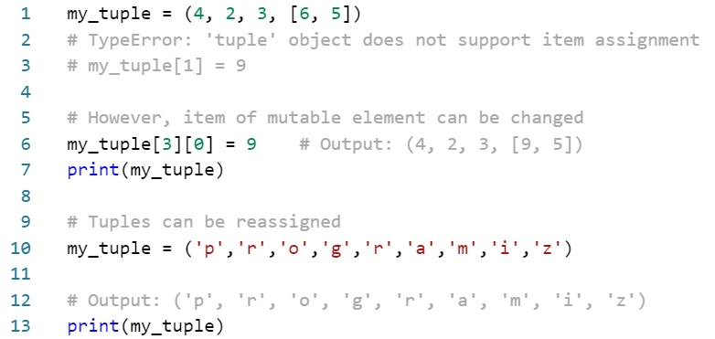
Changing tuple:
Unlike lists, tuples are immutable
This means that elements of a tuple cannot be changed once it has been assigned. But, if the element is itself a mutable datatype like list, its nested items can be changed.

Slide 10
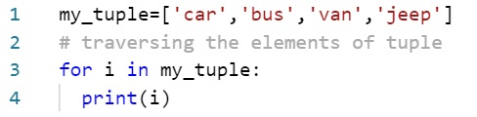

Looping through tuple:
Output:

Slide 11




+ operator and * operator in tuple:
+ operator is used to combine two tuple. This is also called concatenation.
* operator is used to repeat the elements in a tuple for given number of times.

Slide 12
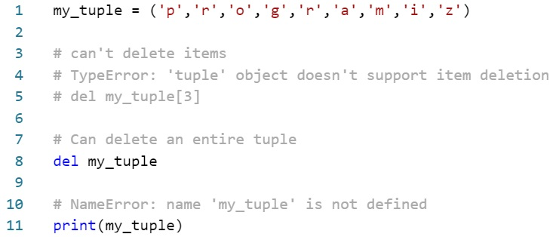
Deleting a tuple:
As we know tuple is immutable, we cannot change the elements in a tuple. This means we cannot delete or remove items from a tuple.
But we can delete entire tuple using the del keyword

Slide 13
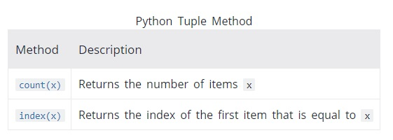
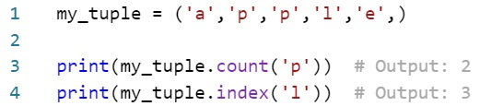
Tuple Methods:

Slide 14
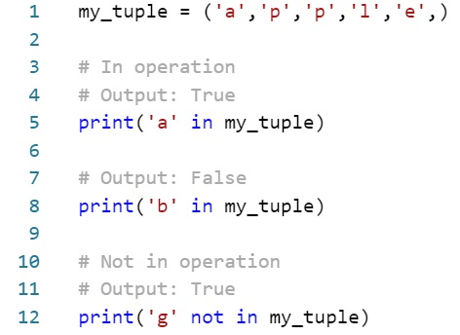
Tuple Membership Test:
We can test the item exists in tuple or not by using ‘in’ keyword

